Slide 1

FALL Project Update
®
Want 2 Remember App®
powered by We2Link, Inc. ®
Notes:
Roger:
Slide Notes:
· Hello, good morning and welcome to our Fall project update powered by We2Link, presentation.

Slide 2

Presentation Outline
CEO Introduction
About We2LinkⓇ
Introduction to the Want2RememberⓇ Project
Software
Technical details
Workflow
Members introduction
Work environment
Q & A
®
Notes:
Roger:
Slide Notes:
· This slide is our representation of our project deliverables we will be presenting today. We will start by introducing Michael Malone, the Founder, CEO, and sponsor of this project.

Slide 3
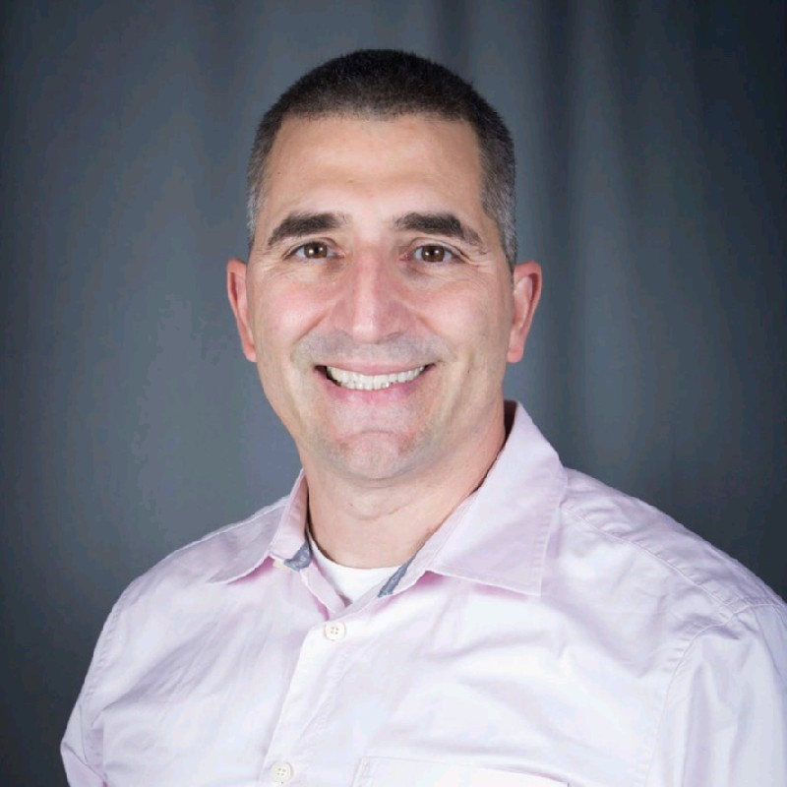
Sponsor, CEO, Michael C. Malone
Founder and CEO of We2Link, Inc.
A Disabled Army Veteran
Developed Traumatic Brain Injury [TBI]
Works with TBI
Interviewed people who had TBI
Designated that this has impacted the Quality of Life [QoL] of people
Roger Ramirez
Notes:
Roger
Slide Notes:
· Michael’s background is that he is an Army Veteran who suffered a traumatic brain injury.
· He began to work with TBI patients by interviewing these surviving patients as well as caregivers and talked to medical professionals at Walter Reed Hospital.
· He gained information and determined that this impairment had impacted the lives of many people, reducing their quality of life which then gave him the idea to create the Want2Remember application.

Slide 4

About We2Link / Purpose
®
Designated to help people who suffer from cognitive impairments
Examples:
Traumatic Brain Injuries [TBI]
Alzheimer's Disease
Dementia
The main purpose:
Help those with cognitive impairments and daily living challenges
The overall goal:
Reduce Isolation
Decrease Caregiver Burden
Reduce Suicide
Achieve Greater Independence
®
Roger Ramirez
Notes:
Roger
Slide Notes:
· We2Link is a company designated to help people who suffer from TBI and other cognitive impairments.
· Examples such as: TBI, Alzheimer's Disease, and Dementia are posing a major vulnerability to the community of veterans, elders and caregivers.
· The main purpose for We2Link is to help those with cognitive impairments and overall daily living challenges while also giving caregivers the ability to live better lives.
These purposes include reducing isolation, decreasing the caregiver’s burden, reduce pressure, anxiety and depression which can result in the reduction of suicide, and achieve an overall greater independence.

Slide 5

The Current Goal of the We2Link
®
The current goal for the company
Tackle problems that include cognitive impairments
Build web features
Implement new features in the future
Implement Caregiver Support
With this, the Want2Remember™ application was developed
Moved on to the Web Application version of the product
®
Roger Ramirez
Notes:
Roger
Slide Notes:
· The current goal at this time is to continue to tackle problems with cognitive impairment.
· The phone application has been developed, using features that can assist with this issue.
· Now, this project has moved on to the next step. We are currently developing a web based version of this project, implementing new features and caregiver support to allow better availability, performance, functionality, ease of use and more.
Handoff:
Now I would like to hand it off to Angelo for more in depth information about the Want2Remember application.

Slide 6
About the Project Want2Remember
Goal
Migrate mobile application to web application.
How it’s Implemented
ReactJS
FireBase (Cloud Support)
What we created for the project.
Very generic components and common single page application functionality.
®
Angelo Esmeralda
Notes:
The current project of Want2Remember in the current state is mostly about implementing the web application version of its original mobile application version.
The mobile application was created with a javascript framework called React Native and the recently created website is being implemented with React and Firebase.
It’s an application that allows the user to create content for themselves that would help them with memory such as reminders and events for memories.
React is a library
The memories don’t always have to be a reminder for the future but for the past as well if a person wants to be reminded about an event that happened in the past in case they forget.
We are currently working on just making very generic components.
Input fields
Page routing
Widgets: Date Picker, Time Picker, etc.
Seniors from last years senior design class worked on the mobile app.

Slide 7
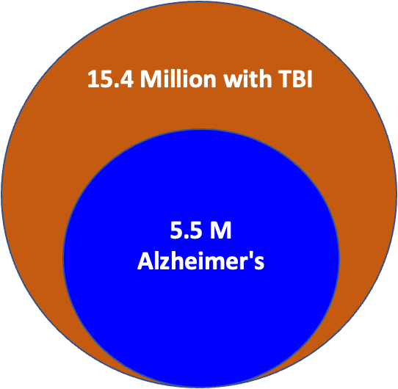

Why the Project is Important
Stats
64.4 million people suffer from cognitive impairment.
15.4 million traumatic brain injuries.
5.5 million people with alzheimer's.
About 40% of the people that are of ages 65 or older have age associated memory impairment in the US.
About 1% of them will progress to dementia each year.
Improved support for caregivers.
43.5 million unpaid caregivers.
Features for virtual caregiving.
Angelo Esmeralda
Notes:
According to an article written by National library of medicine. About 40% of the people that are of ages 65 or older have age associated memory impairment in the US. That’s about 16 million people having trouble with their cognitive abilities.
That same article states that About 1% of them will progress to dementia each year.
This is something we should worry about not just for others but for ourselves as well because eventually most this will be the future for 40% of us.

Slide 8






Project Requirements/Tech Stack
Programming/Development:
JavaScript/React
HTML
Tailwind CSS
Firebase
Source Control:
GitHub
Jira (Agile Tracking)
Marco Gonzalez and Ryan McKean
Notes:
Introduce tools all in this slide.

Slide 9

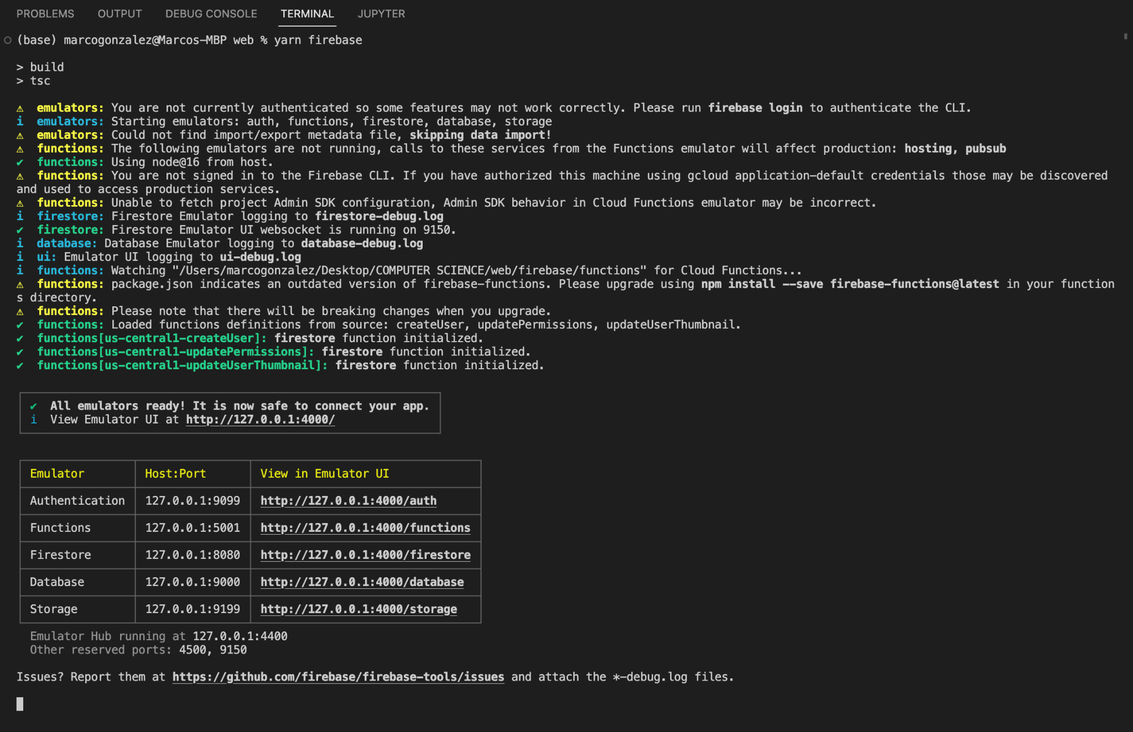
Why Firebase for Want2Remember®️?
Firebase is a realtime Google database used to host Want2RememberⓇ’s cloud data.
Firebase for us Want2Remember™️ developers has been mainly as an emulator of a future permanent cloud database.
The database emulator allows devs to edit and view the web application in real time.
yarn firebase to start firebase emulators
Marco Gonzalez and Ryan McKean

Slide 10
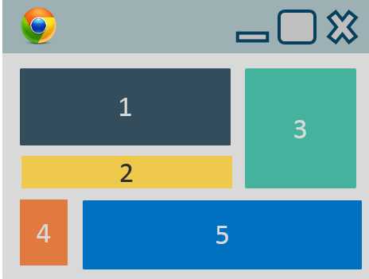


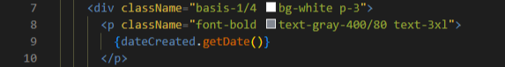
Why React for Want2Remember®️?
®️
React works through JavaScript.
React allows for flexibility on many devices.
We utilize React components like building blocks.
Developers can manage state and effects for each component.
Tailwind CSS is also being used for more efficient styling
Marco Gonzalez and Ryan McKean
Notes:
Notes:
Another essential tool for the Want2Remember app is React; And React is a JS library. We use it because JS is a very versatile and powerful language especially for web applications. The fluidity of JS allows us to code a website that can be adapted and scaled to all kinds of devices with different screen sizes and hardwares.
That said, a leading reason we use React is because React utilizes components to build a web app. A component is just what it sounds like, it's an individual aspect or function of a web page. These components can be used like building blocks to create pages, and each component can be used multiple times and by other developers. If it helps you can think of it like a LEGO set, and the developers are each building small chunks of a set, and when all the chunks are put together, you get the completed project.
An impressive part of React is the level of separation between components such as the state and effects which can be managed by the developer per component. Allowing for a very smooth and interactive UI.
Additionally, React also supports Tailwind CSS. This gives us inline HTML styling using an efficient framework which clears up many CSS files and makes real time style edits much simpler.

Slide 11
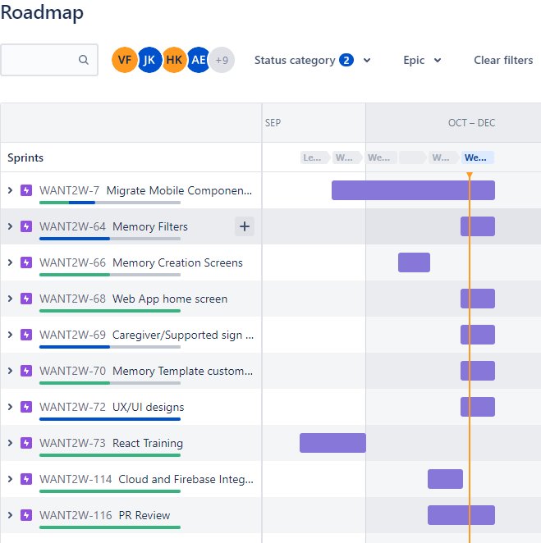
Completed Tasks
Completed a 48 hour online react course
12/58 components reviewed and merged
203 hours total time spent developing
Completed pull request reviews
Ryan McKean
Notes:
This slide is a very basic breakdown of our roadmap and current progress with the project. (The image on the right is the roadmap for W2R in Jira)
For the first sprint which is two weeks long, we utilized Udemy to learn the React dom and how to code using the React library.
At this point, a little over 20% of components are completed. However, these completed components are the groundwork for most of the project. Our team will be utilizing what we have already built and adapt it to finish the application.
And to keep track of our progress, our time spent developing is tracked per task or component through Jira. Jira is going to be covered more in depth later.
And finally, when a task is completed, a github pull request is created to review the code. Again, this process will be covered in more detail later in the pres.

Slide 12
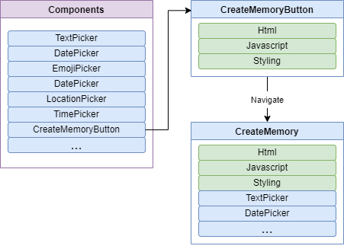
Overall Project Architecture
Based on react components
Modular
Reusable
Victor Flores and Salvador Cornejo
Notes:
Victor

Slide 13
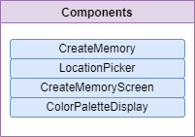
In Depth Component Review
What do they do
Libraries used
Concepts
Notes:
Victor
Color palette supports the 4 type

Slide 14
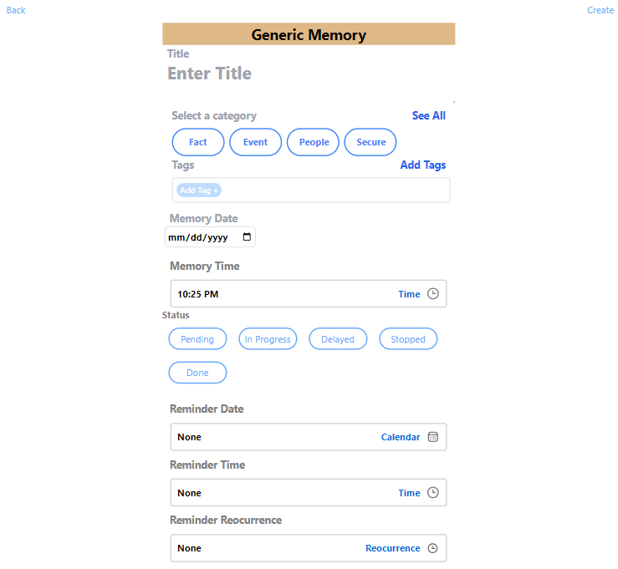
Memory Creation
Used for creating memories
Libraries used are Dayjs and Calendar
Saved data by user is updated using useState from react.
Victor Flores and Salvador Cornejo
Notes:
salvador

Slide 15
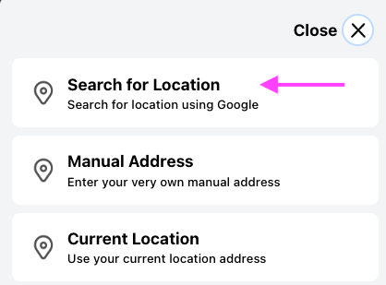
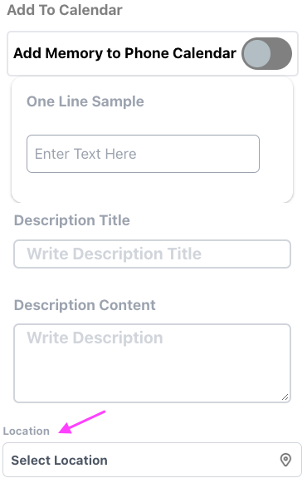
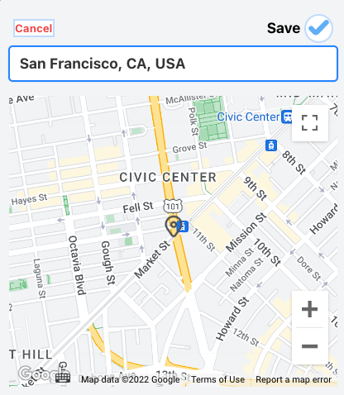
Location Picker
Offers three different location options.
Uses javascript navigator geolocation to get current location.
Uses google-map-react, react-geocode, and react-google-places-autocomplete
Victor Flores and Salvador Cornejo
Notes:
SALVADOR

Slide 16
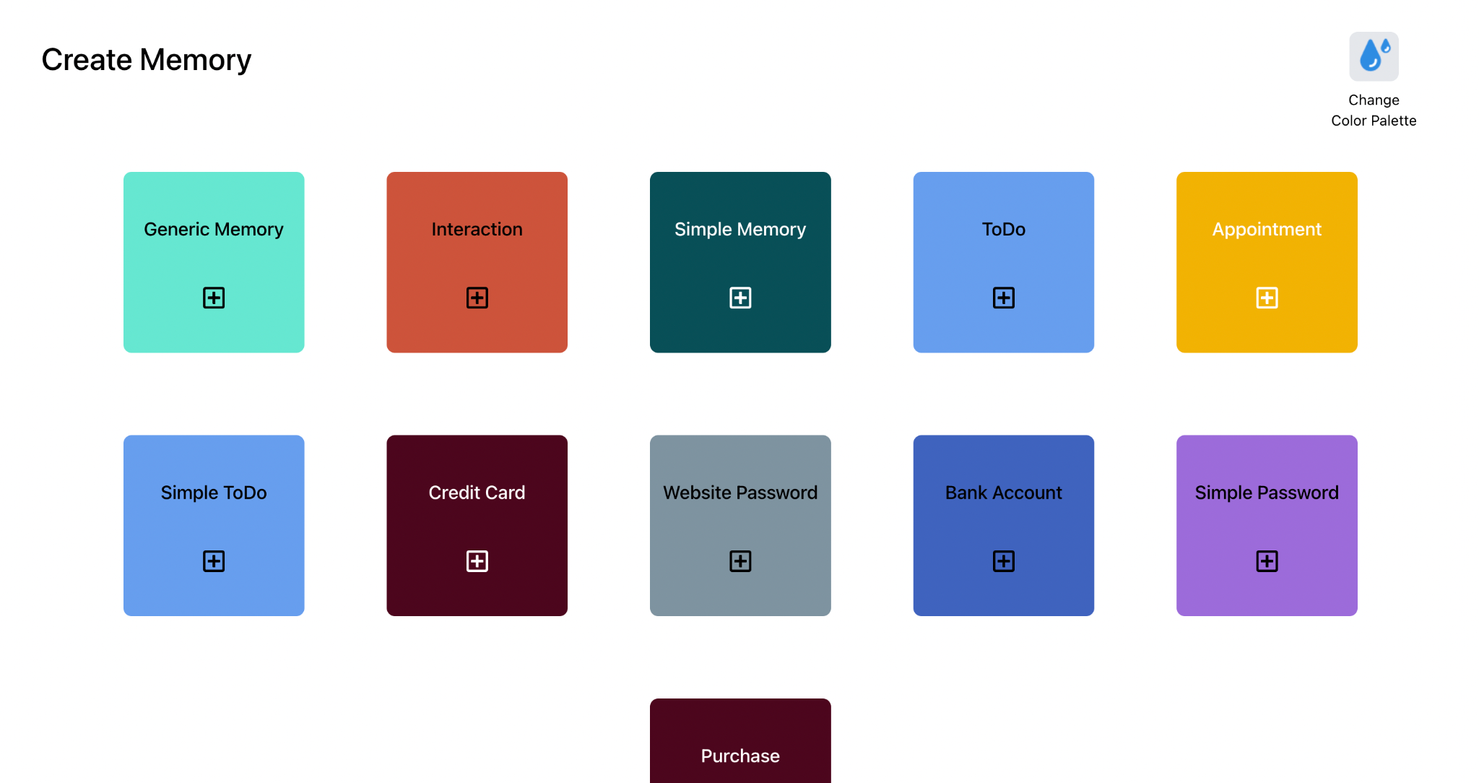
Create Memory Screen
Allows the user to select the type of memory they want to create
Reads color palette from firebase
Harshil and Jonah
Notes:
harshil

Slide 17
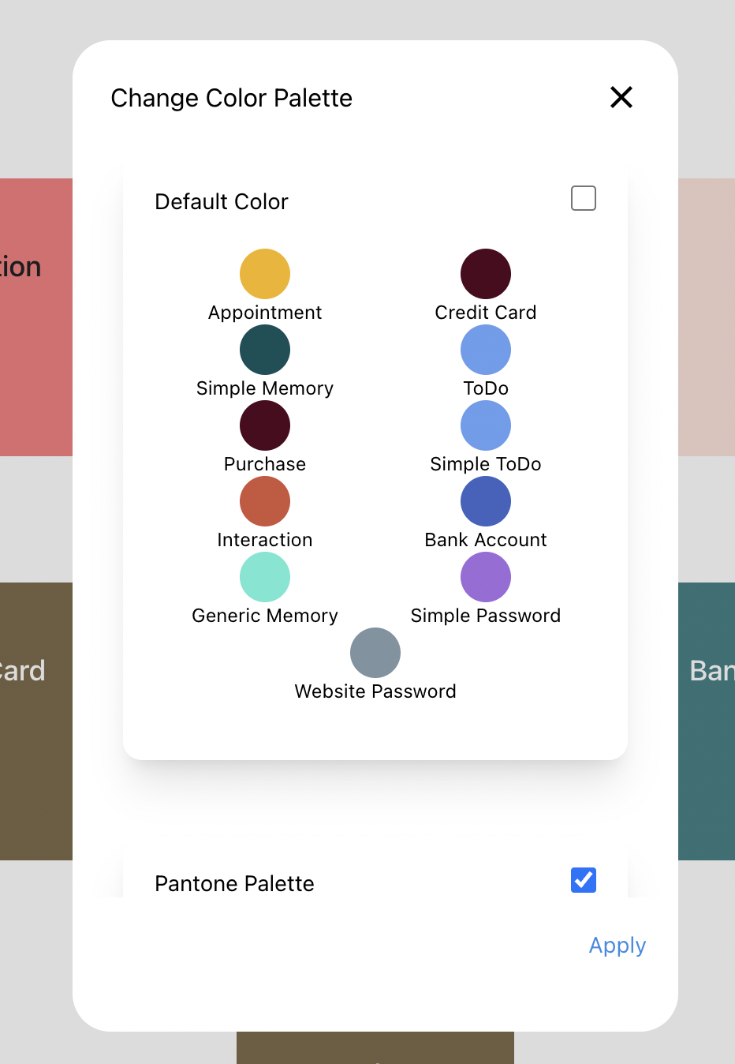
Customize Memory Screen Colors
Implemented a screen for color palettes
User is able to click on the checkbox at the top right to select a specific palette.
The color palette data is created and stored on firebase when the user signs in.
Users can change the palette and edit palettes, all changes are stored on firebase
Harshil and Jonah
Notes:
harshil

Slide 18
What We Will Be Doing (End of Semester)
We will continue adding components to the web application and make it as close as possible to the mobile application.
Add a help and feedback feature for the web app.
Files can be imported
Provide more customization for the user
Ability to toggle between different page views
Change the background color
Harshil and Jonah
Notes:
Jonah

Slide 19
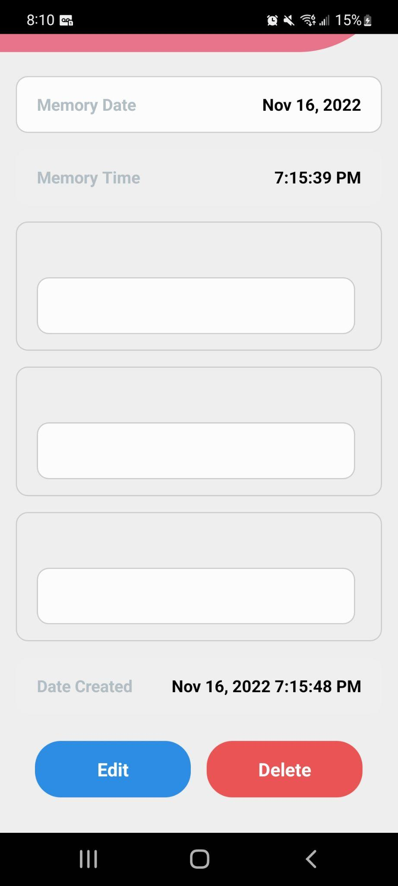
Editing / Deleting Memories
User can click on their memories and edit information about them
An option to delete an existing memory
Quick Look UI and Create Screens are currently implemented, but integrations to firebase will need to be made
Firebase will need to store the data for each individual memory
Harshil and Jonah
Notes:
jonah

Slide 20
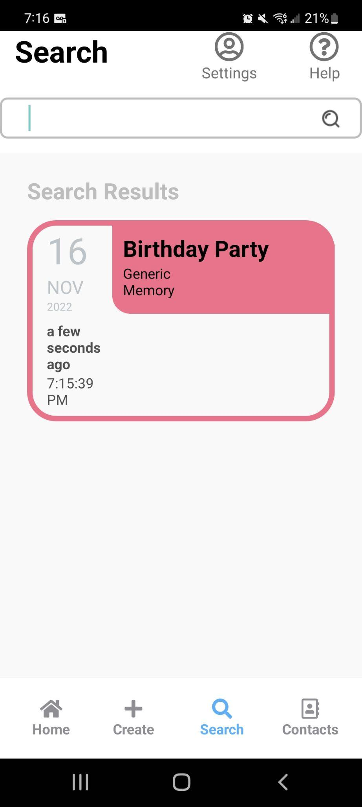
Add a Search Menu for Memories
Allows users to search for existing memories
Figure out which search algorithm will work best for our necessities
Users should be a able to see a preview of their memories below the search bar
Harshil and Jonah
Notes:
jonah

Slide 21
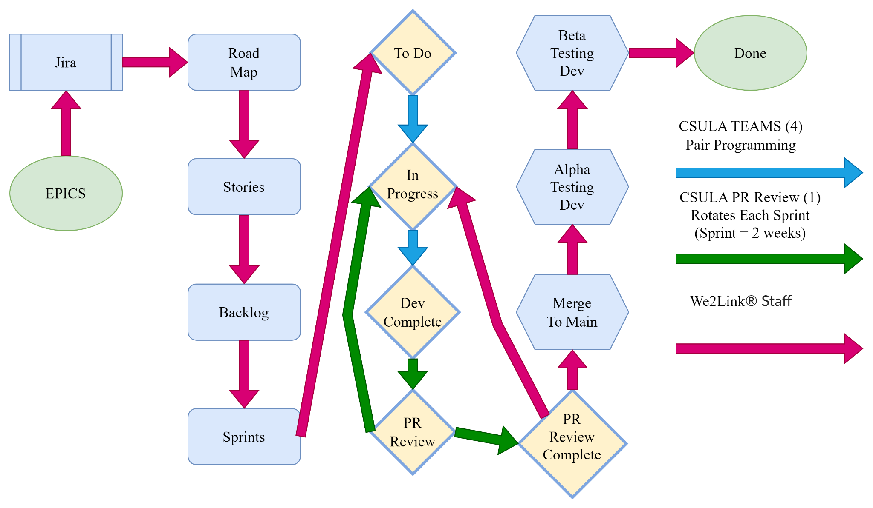
Workflow
Notes:
David

Slide 22
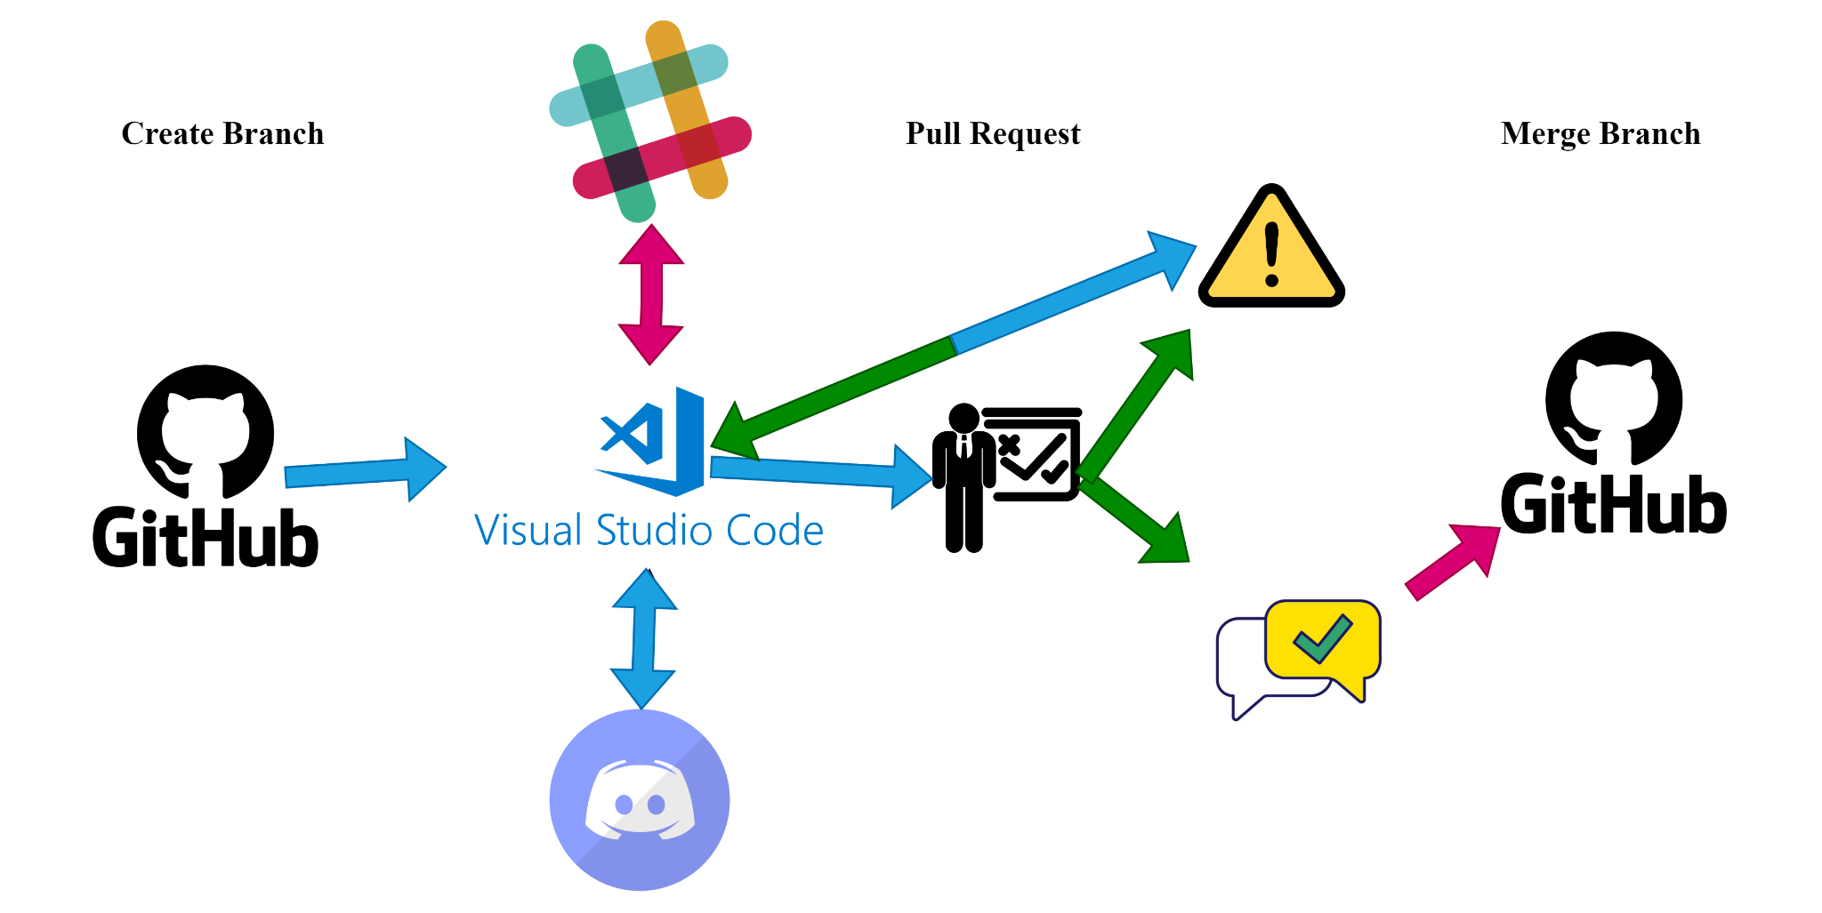
Slack
Changes
Needed
Discord
Approved
Notes:
David

Slide 23

Our Team
®️
Jesse Gonzalez David Pablo | - - | Project Co-Lead Project Co-Lead
Harshil Kotamreddy Jonah Kim | - - | Note Taker / Software Developer Software Developer
Ryan Mckean Marco Gonzalez | - - | Software Developer Software Developer
Salvador Cornejo Victor Flores | - - | Software Developer Software Developer
Roger Ramirez Angelo Esmeralda | - - | Note Taker / Software Developer Software Developer
Michael Malone
Dr. Zilong Ye
Ricardo Marroquin
-
-
-
Sponsor / CEO
Advisor
We2LinkⓇ Liaison
Notes:
Show pairs. Describe pair roles
Notes:
Dr. Ye, faculty advisor keeps team informed of Senior Design assignments
Ricardo, liaison for We2Link, can go to him for questions and clarification
W2R project team is divided into groups of 2.
Allows for efficient designation of tasks as well as diversifying skill sets between two people
Can mention that there are groups of 2 also because one might not be able to make it and the other can occupy that space.

Slide 24

Work Environment
2 Zoom Meetings a Week
In progress review
First 2 weeks
How it’s going
Sprint Retrospective
How it went
Work from home
Visual Studio Live Share
GitHub Desktop
Notes:
jesse

Slide 25

Communication
Slack
CEO
Liaison
Discord
Group Members
Team Meetings
GitHub Pull Request
Reviews
Changes needed
Notes:
Jesse

Slide 26

Q & A
Notes:
david

